Slide 1




Slide 2
Tokenization
Notes:
Hello and welcome, in this video we will start to dive into the components of the internal structure of transformers.

Slide 3


Introduction
Tokenization

Slide 4
What will we discuss?
What’s the tokenization?
Why it's a vital process in various fields of technology?

Slide 5
What’s the tokenization?
Tokenization is a powerful technique used in natural language processing. It involves breaking down text into smaller units called tokens.
These tokens can be individual words, sentences, or even smaller components like characters or subwords.
Tokenization enables machines to understand and process human language effectively.
Tokenizing text is a core task of NLP
['Tokenizing', 'text', 'is', 'a', 'core', 'task', 'of', 'NLP.’]
https://blog.feedly.com/nlp-breakfast-2-the-rise-of-language-models/

Slide 6
Character Tokenization
The simplest tokenization scheme is to feed each character individually to the model.
Implement character-level tokenization :
Numericalization: converted each character into an integer.
Transform the tokenized text to a list of integers.
text = "Tokenizing text is a core task of NLP."
tokenized_text = list(text)
print(tokenized_text)
['T', 'o', 'k', 'e', 'n', 'i', 'z', 'i', 'n', 'g', ' ', 't', 'e', 'x', 't', ' ', 'i', 's', ' ', 'a', ' ', 'c', 'o', 'r', 'e', ' ', 't', 'a', 's', 'k', ' ', 'o', 'f', ' ', 'N', 'L', 'P', '.']
token2idx = {ch: idx for idx, ch in enumerate(sorted(set(tokenized_text)))}
print(token2idx)
{' ': 0, '.': 1, 'L': 2, 'N': 3, 'P': 4, 'T': 5, 'a': 6, 'c': 7, 'e': 8, 'f': 9, 'g': 10, 'i': 11, 'k': 12, 'n': 13, 'o': 14, 'r': 15, 's': 16, 't': 17, 'x': 18, 'z': 19}
input_ids = [token2idx[token] for token in tokenized_text]
print(input_ids)
[5, 14, 12, 8, 13, 11, 19, 11, 13, 10, 0, 17, 8, 18, 17, 0, 11, 16, 0, 6, 0, 7, 14, 15, 8, 0, 17, 6, 16, 12, 0, 14, 9, 0, 3, 2, 4, 1]

Slide 7
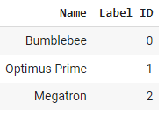
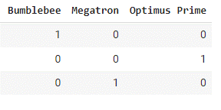
Character Tokenization
convert input_ids to a 2D tensor of one-hot vectors.
One-hot vectors are frequently used in machine learning to encode categorical data.
One-hot vectors approach creates a fictitious ordering between the names. → create a new column for each category and assign a 1 where the category is true, and a 0 otherwise
import pandas as pd
categorical_df = pd.DataFrame( { "Name" : ["Bumblebee" , "Optimus Prime" , "Megatron" ], "Label_ID" : [0, 1, 2]})
pd.get_dummies(categorical_df["Name" ])

Slide 8
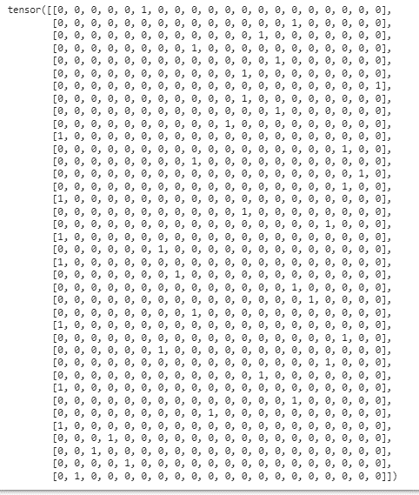
Character Tokenization
Input_ids problem: the elements create an ordinal scale.
→ One Hot Encoding can easily be interpreted: the two entries that are “hot” indicate that the corresponding tokens co-occur.
[5, 14, 12, 8, 13, 11, 19, 11, 13, 10, 0, 17, 8, 18, 17, 0, 11, 16, 0, 6, 0, 7, 14, 15, 8, 0, 17, 6, 16, 12, 0, 14, 9, 0, 3, 2, 4, 1]
import torch
import torch.nn.functional as F
input_ids = torch.tensor(input_ids)
one_hot_encodings = F.one_hot( input_ids , num_classes = len(token2idx) )
one_hot_encodings.shape
torch.Size([38, 20])

Slide 9
Character Tokenization
Input_ids problem: the elements create an ordinal scale.
→ One Hot Encoding can easily be interpreted: the two entries that are “hot” indicate that the corresponding tokens co-occur.
Examine output:
[5, 14, 12, 8, 13, 11, 19, 11, 13, 10, 0, 17, 8, 18, 17, 0, 11, 16, 0, 6, 0, 7, 14, 15, 8, 0, 17, 6, 16, 12, 0, 14, 9, 0, 3, 2, 4, 1]
import torch
import torch.nn.functional as F
input_ids = torch.tensor(input_ids)
one_hot_encodings = F.one_hot( input_ids , num_classes = len(token2idx) )
one_hot_encodings.shape
torch.Size([38, 20])
→
Token: T Tensor index: 5 One-hot: tensor([0, 0, 0, 0, 0, 1, 0, 0, 0, 0, 0, 0, 0, 0, 0, 0, 0, 0, 0, 0])
print(f"Token: {tokenized_text[0]}" )
print(f"Tensor index: {input_ids[0]}" )
print(f"One-hot: {one_hot_encodings[0]}" )
→
→

Slide 10
Character Tokenization
Character-level tokenization ignores any structure in the text and treats the whole string as a stream of characters.
It helps deal with misspellings and rare words.
The main drawback is that linguistic structures such as words need to be learned from the data.
This requires significant compute, more memory, and large data.
→ Character tokenization is rarely used in practice.

Slide 11
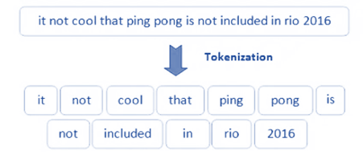
Word Tokenization
Using words from the outset enables the model to skip the step of learning words from characters, and thereby reduces the complexity of the training process.
tokenized_text = text.split()
print(tokenized_text)
['Tokenizing', 'text', 'is', 'a', 'core', 'task', 'of', 'NLP.']

Slide 12
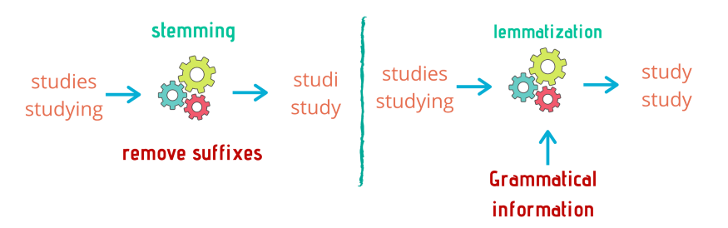
Word tokenization problems
Punctuation is not accounted for, so NLP and ” . “ are treated as a single token.
Words can include declinations, conjugations, or misspellings, the size of the vocabulary can easily grow into millions.
Some word tokenizers have extra rules for punctuation. One can also apply stemming or lemmatization.
Which normalizes words to their stem such as great, greater, and greatest all become “great”
→ Losing some information in the text.
['Tokenizing', 'text', 'is', 'a', 'core', 'task', 'of', 'NLP.']
https://www.kdnuggets.com/2021/02/6-nlp-techniques.html

Slide 13
Word Tokenization
Large vocabulary → Increases number of parameters.
[Word_1, Word_2, Word_3, Word_4,………., Word_${10}^{6}$]

Slide 14
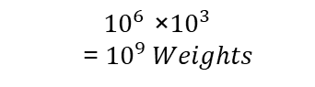

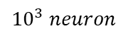
Word Tokenization
Large vocabulary → Increases number of parameters.
[Word_1, Word_2, Word_3, Word_4,………., Word_${10}^{6}$]
Layer 1
$${10}^{6}word$$
$${10}^{3} neuron$$
$${10}^{6} \text{×}{10}^{3}$$
=${ 10}^{9} Weights$

Slide 15
Word Tokenization
Large vocabulary → Increases number of parameters.
[Word_1, Word_2, Word_3, Word_4,………., Word_${10}^{6}$]
Layer 1
$${10}^{6}word$$
$${10}^{3} neuron$$
$${10}^{6} \text{×}{10}^{3}$$
=${ 10}^{9} Weights$
This is already comparable to the largest GPT-2 model, which has around 1.5 billion parameters in total.

Slide 16
Word Tokenization
Problem → being so wasteful with our model parameters since models are expensive to train, and larger models are more difficult to maintain.
Solution→ limit the vocabulary and discard rare words
Say, the 100,000 most common words in the corpus.
Words that are not part of the vocabulary are classified as “unknown” and mapped to a shared UNK token.
Drawbacks: → lose some potentially important information since the model has no information about words associated with UNK token.
These drawbacks of character and word tokenization lead us to find a tokenization method that preserved drawbacks the input information and some of the input structure

Slide 17
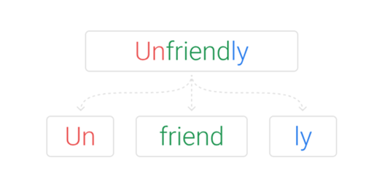
Subword tokenization
The basic idea behind Subword tokenization is to combine the best aspects of character and word tokenization.
Benefits:
Split rare words into smaller units to allow the model to deal with complex words and misspellings.
Keep frequent words as unique entities so that we can keep the length of our inputs to a manageable size.
https://www.thoughtvector.io/blog/subword-tokenization/

Slide 18
Subword tokenization: Wordpiece
Wordpiece which is used by the BERT and DistilBERT tokenizers.
The AutoTokenizer class belongs to a larger set of “auto” classes whose job is to automatically retrieve the model’s configuration, pretrained weights, or vocabulary from the name of the checkpoint.
If you wish to load the specific class manually you can do so as well.
from transformers import AutoTokenizer
model_ckpt = "distilbert-base-uncased"
tokenizer = AutoTokenizer.from_pretrained(model_ckpt)
from transformers import DistilBertTokenizer
distilbert_tokenizer = DistilBertTokenizer.from_pretrained(model_ckpt)

Slide 19
Subword tokenization: Wordpiece Example
text = "Tokenizing text is a core task of NLP"
encoded_text = tokenizer(text)
print(encoded_text)
To change the input_ids back to tokens, we can use the tokenizer’s convert_ids_to_tokens() method:
{ 'input_ids': [101, 19204, 6026, 3793, 2003, 1037, 4563, 4708, 1997, 17953, 2361, 1012, 102], 'attention_mask': [1, 1, 1, 1, 1, 1, 1, 1, 1, 1, 1, 1, 1]}
tokens = tokenizer.convert_ids_to_tokens(encoded_text.input_ids)
print(tokens)
['[CLS]', 'token', '##izing', 'text', 'is', 'a', 'core', 'task', 'of', 'nl', '##p', '.', '[SEP]']

Slide 20
Subword tokenization: Wordpiece Example
text = "Tokenizing text is a core task of NLP"
encoded_text = tokenizer(text)
print(encoded_text)
To change the input_ids back to tokens, we can use the tokenizer’s convert_ids_to_tokens() method:
The # prefixes mean that the preceding string is not whitespace
{ 'input_ids': [101, 19204, 6026, 3793, 2003, 1037, 4563, 4708, 1997, 17953, 2361, 1012, 102], 'attention_mask': [1, 1, 1, 1, 1, 1, 1, 1, 1, 1, 1, 1, 1]}
tokens = tokenizer.convert_ids_to_tokens(encoded_text.input_ids)
print(tokens)
['[CLS]', 'token', '##izing', 'text', 'is', 'a', 'core', 'task', 'of', 'nl', '##p', '.', '[SEP]']
print(tokenizer.convert_tokens_to_string(tokens))
[CLS] tokenizing text is a core task of nlp. [SEP]

Slide 21
Subword tokenization: Wordpiece Example
The AutoTokenizer class Attributes:
Vocabulary size.
The corresponding model’s maximum context size.
The names of the fields that the model expects in its forward pass.
print(tokenizer.convert_tokens_to_string(tokens))
30522
tokenizer.vocab_size
512
tokenizer.model_input_names
['input_ids', 'attention_mask']

Slide 22
Dataset Tokenization
load the emotion dataset with the load_dataset() function.
#! pip install datasets
from datasets import load_dataset
emotions = load_dataset("emotion" )
emotions
DatasetDict({
train: Dataset({
features: ['text', 'label'],
num_rows: 16000
})
validation: Dataset({
features: ['text', 'label'],
num_rows: 2000
})
test: Dataset({
features: ['text', 'label'],
num_rows: 2000
})
})

Slide 23
Dataset Tokenization
load the emotion dataset with the load_dataset() function.
#! pip install datasets
from datasets import load_dataset
emotions = load_dataset("emotion" )
emotions
DatasetDict({
train: Dataset({
features: ['text', 'label'],
num_rows: 16000
})
validation: Dataset({
features: ['text', 'label'],
num_rows: 2000
})
test: Dataset({
features: ['text', 'label'],
num_rows: 2000
})
})

Slide 24
Dataset Tokenization
load the emotion dataset with the load_dataset() function.
#! pip install datasets
from datasets import load_dataset
emotions = load_dataset("emotion" )
emotions
DatasetDict({
train: Dataset({
features: ['text', 'label'],
num_rows: 16000
})
validation: Dataset({
features: ['text', 'label'],
num_rows: 2000
})
test: Dataset({
features: ['text', 'label'],
num_rows: 2000
})
})

Slide 25
Dataset Tokenization
Apply the tokenizer to a batch of examples:
def tokenize(batch):
return tokenizer( batch["text" ], padding = True, truncation = True )

Slide 26
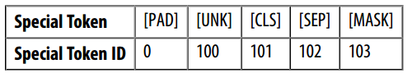
Dataset Tokenization
Apply the tokenizer to a batch of examples:
Pass a batch of two examples from the training set:
def tokenize(batch):
return tokenizer( batch["text" ], padding = True, truncation = True )
def tokenize(batch):
return tokenizer(batch["text" ][:2], padding=True, truncation=True)
tokenize(emotions['train'])
{ 'input_ids': [ [101, 1045, 2134, 2102, 2514, 26608, 102, 0, 0, 0, 0, 0, 0, 0, 0,0, 0, 0, 0, 0, 0, 0, 0], [101, 1045, 2064, 2175, 2013, 3110, 2061, 20625, 2000, 2061, 9636, 17772, 2074, 2013, 2108, 2105, 2619, 2040, 14977, 1998, 2003, 8300,102]],
'attention_mask’: [ [1, 1, 1, 1, 1, 1, 1, 0, 0, 0, 0, 0, 0, 0, 0, 0, 0, 0,0, 0, 0, 0, 0], [1, 1, 1, 1, 1, 1, 1, 1, 1, 1, 1, 1, 1, 1, 1, 1, 1, 1, 1, 1, 1,1, 1]] }

Slide 27
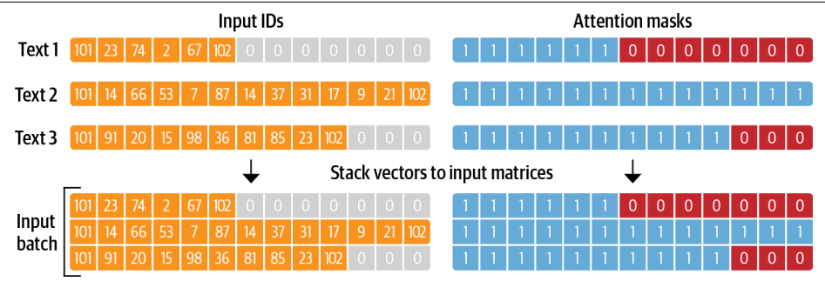
Dataset Tokenization
The attention mask allows the model to ignore the padded parts of the input.
Length in the batch; the attention mask is used in the model to ignore the padded areas of the input tensors.
{ 'input_ids': [ [101, 1045, 2134, 2102, 2514, 26608, 102, 0, 0, 0, 0, 0, 0, 0, 0,0, 0, 0, 0, 0, 0, 0, 0], [101, 1045, 2064, 2175, 2013, 3110, 2061, 20625, 2000, 2061, 9636, 17772, 2074, 2013, 2108, 2105,, 2040, 14977, 1998, 2003, 8300,102]],
'attention_mask': [ [1, 1, 1, 1, 1, 1, 1, 0, 0, 0, 0, 0, 0, 0, 0, 0, 0, 0,0, 0, 0, 0, 0], [1, 1, 1, 1, 1, 1, 1, 1, 1, 1, 1, 1, 1, 1, 1, 1, 1, 1, 1, 1, 1,1, 1]] }

Slide 28
Dataset Tokenization
Apply tokenization across all the splits in the corpus in a single line of code
emotions_encoded = emotions.map(tokenize, batched=True, batch_size=None)
emotions_encoded

Slide 29
Dataset Tokenization
Apply tokenization across all the splits in the corpus in a single line of code
emotions_encoded = emotions.map(tokenize, batched=True, batch_size=None)
emotions_encoded

Slide 30
Dataset Tokenization
Apply tokenization across all the splits in the corpus in a single line of code
emotions_encoded = emotions.map(tokenize, batched=True, batch_size=None)
emotions_encoded
DatasetDict({
train: Dataset({
features: ['text', 'label', 'input_ids', 'attention_mask'],
num_rows: 16000
})
validation: Dataset({
features: ['text', 'label', 'input_ids', 'attention_mask'],
num_rows: 2000
})
test: Dataset({
features: ['text', 'label', 'input_ids', 'attention_mask'],
num_rows: 2000
})
})
'input_ids’ and 'attention_mask' represent the numerical representation of the input needed to start training or fine-tuning transformer model

Slide 31
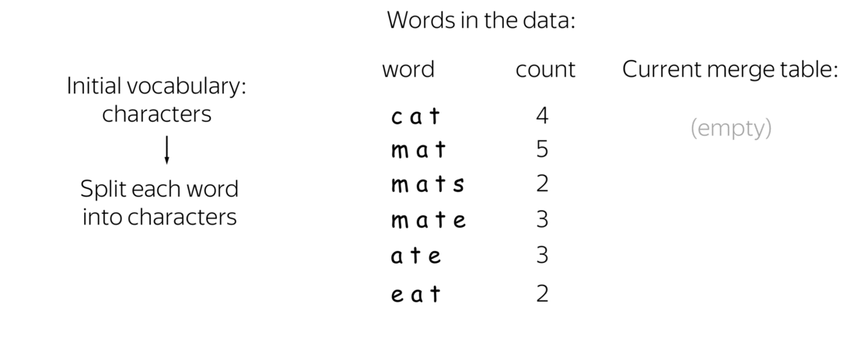
Byte Pair Encoding tokenization
BPE is one of the earliest and most widely used in training subword-level neural language models.
It's a form of subword tokenization that breaks down words into smaller units.
It starts with a vocabulary of characters or character sequences and iteratively merges the most frequent pairs of units not already in the vocabulary.
GPT-3 →Byte-Level BPE
it looks at words as being written with bytes not as Unicode characters.
https://colab.research.google.com/github/catalyst-team/dl-course/blob/master/week-09/seminar_done.ipynb

Slide 32


